Slide 1
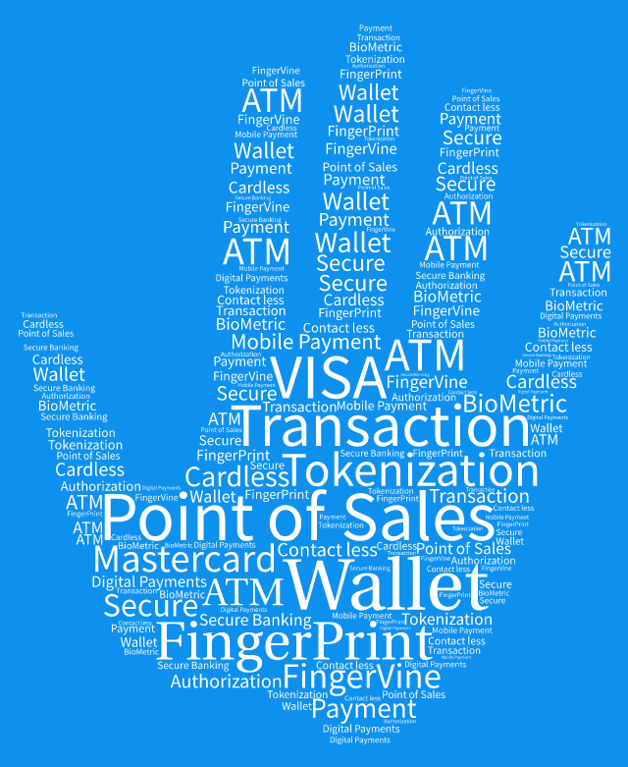
F Pay
Secured Payments

Slide 2




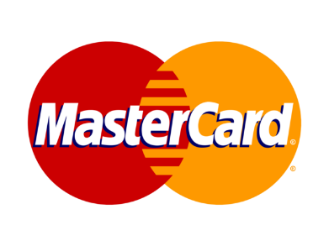

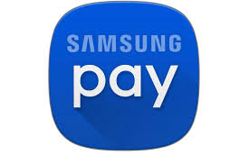


Leading Players - Digital Payments

Slide 3
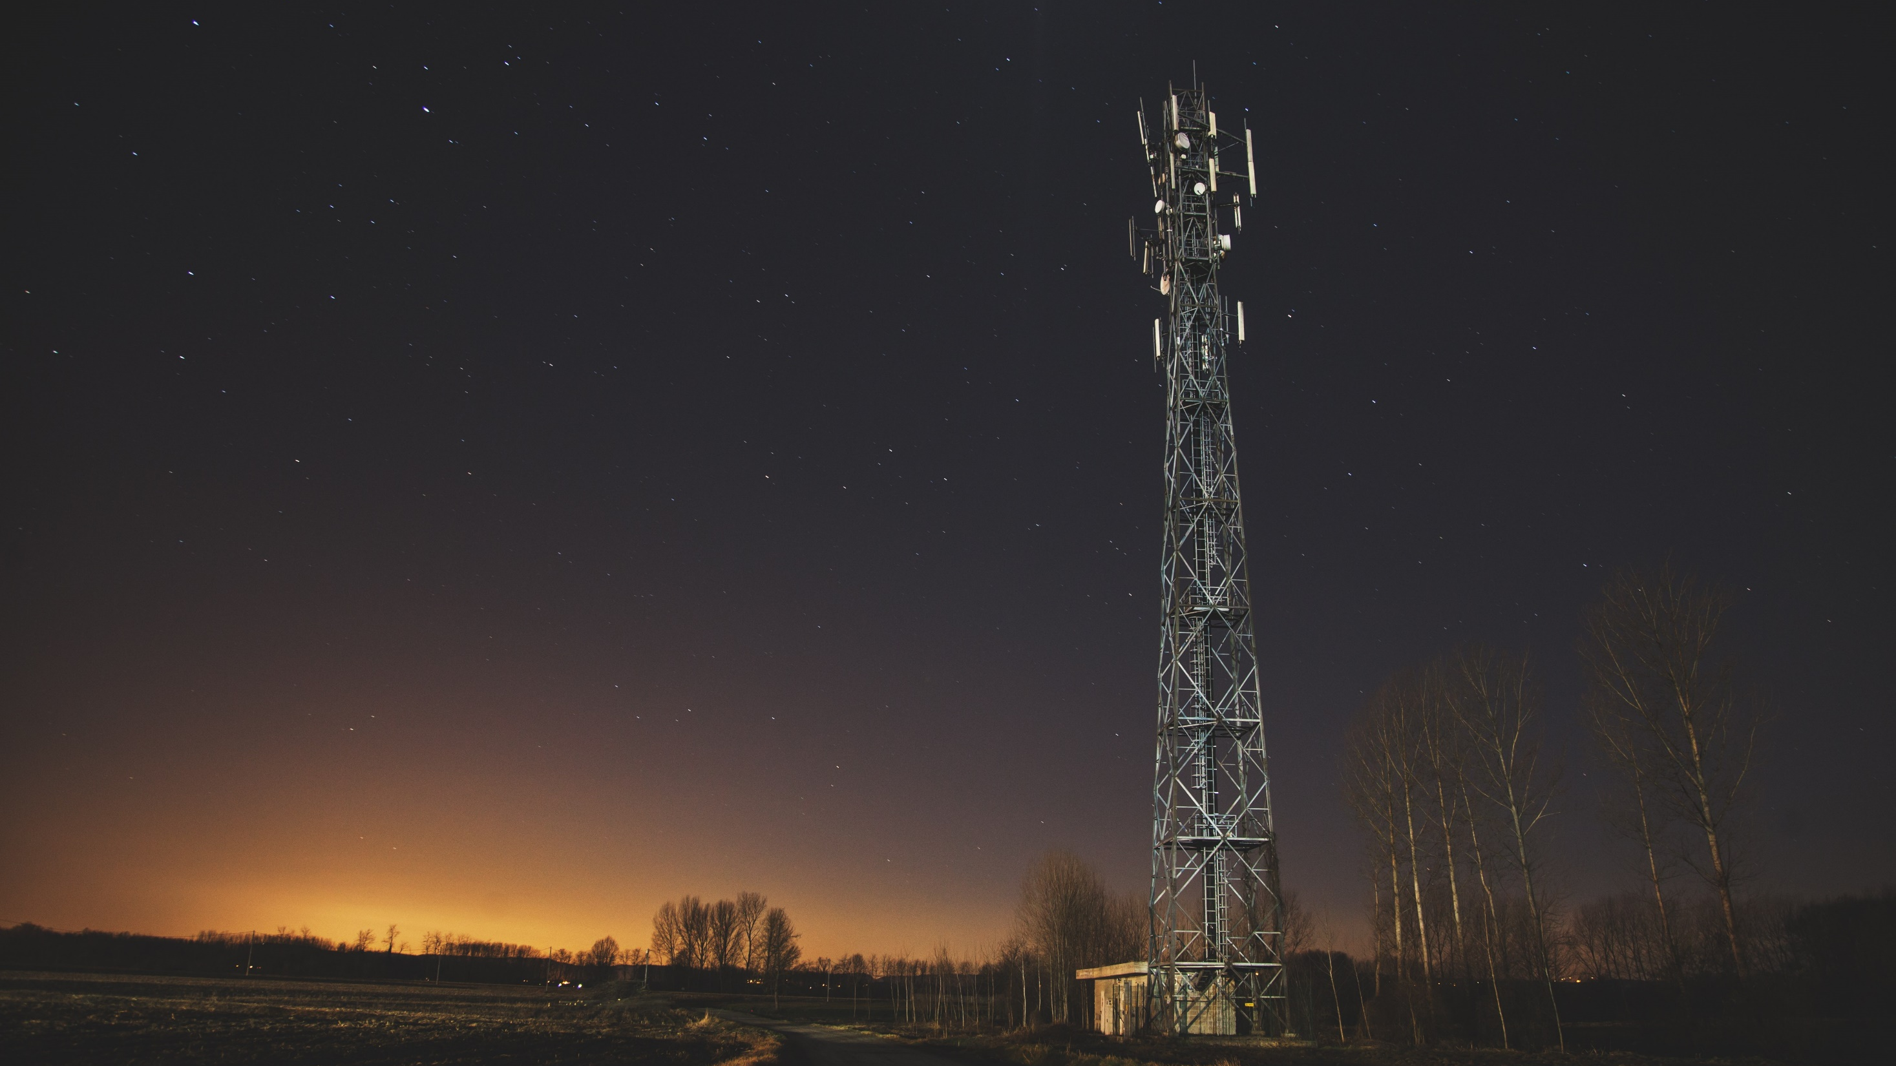
“
If you stop
Dreaming you
Will stop
Advancing.”
— Louis Twelve
Notes:
Delete image and Place your own picture.

Slide 4
As a bank, we must plan to win, prepare to win, and expect to win.

Slide 5

F Pay
Simple Secured Convenient

Slide 6
How it works ?
Enrolment
F Pay Account creation with Biometric data
Payment
Where user purchase goods at POS terminal with Fingerprints

Slide 7
F Pay Enrolment Process
Fingerprint Registration
Identity Verification
Add Card to Account
Customer must verify his email and mobile number security purpose
Customer can add more than one card but choose one card as prime
F Pay Account
03
Registration Completed
Simple and doesn’t require no more than email and mobile
Biometric Enrolment
Customer is now ready for FPay based payments at POS
02
OTP Verification
04
Card Enrolment
01
Registration
05
Ready To Pay
FPay supports all debit and credit cards issued by all the banks but subject to card network. FPay does not store card details for any purpose. FPay delagtes card details to card network. FPay will not involve in any Payment Transaction flow. FPay will not store any biometric data in raw form.

Slide 8

Payment Process
Touch to pay
Payment Process
Take out goods

Slide 9

Technical Overview of Transaction Flow
POS
POS
POS sends the fingerprint to F Pay to get token details for further process
POS sends the Token to Circuit for Payment Process
Normal Circuit
Fingerprint
F Pay
User scans his fingerprint at POS terminal
F Pay validates and returns prime card token to POS
Normal Circuit Transaction happens
9
9

Slide 10
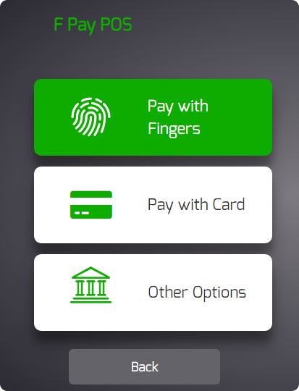


F Pay POS

Slide 11
Apps on Every Platform
Tablet or Phone
Full Fledged POS
Desktops with POS

Slide 12

Benefits of App Model
App Updates
Easy to push updates to app than firmware
Easy to Replace
Apps are easy to replace then hardware devices
Full Control on App
Since we develop the app, we have control to choose features
Cost Effective
Apps based development is less cost then hardware based counterparts
Modular
Can bring any number of software and hardware modules to work together
Future Proof
Since it is app, we develop extensions to support any modules

Slide 13
Are we in right track ?

Slide 14
VISA 2016
Visa Biometric Authentication Study
Research Overview
Total Samples: 14,236
Fieldwork dates: 22nd April – 6th May 2016
Markets: France, Germany, Italy, Poland, Spain, Sweden And UK

Slide 15
VISA 2016
Visa Biometric Authentication Study
How they want to secure a payment ?
78%
68%
of respondents view two-factor authentication as a secure way to confirm an account holder,
of people said they want to use biometrics as a method of payment authentication.

Slide 16
Why they want biometric based secure payments ?
Visa Biometric Authentication Study
65%
Italy
48%
51%
Most confident in the speed and efficiency biometric methods provides
Europe
Europe
37%
faster and easier than passwords or PINs.
over 65s say that it would eliminate the need to remember multiple passwords
33%
Europe
Europe
over 65s recognize the security it provides
Pay anytime, anywhere as the method is part of them

Slide 17
Visa Biometric Authentication Study
31%
31%
Europe
18-24 year olds say they are likely to switch away from their mobile handset provider if they didn’t offer a biometric form of payment in the future
Europe
39%
of respondents have abandoned a purchase online because of the tedium of the payment security process
Europe
25-34 year olds say they are likely to switch away from their bank if they did not offer a biometric form of payment in the future
These numbers goes on.
84%
Europe
84% say that they would trust biometric authentication if it was provided by their bank
17
17

Slide 18
Which Biometric They think Secure
76% votes for Iris
Overs 76% of people in Europe says Iris authentication is preferred and is more secure
81% votes for fingerprint
Overs 81% of people in Europe says finger print authentication is preferred and is more secure

Slide 19

Customer Preference
Fingerprint
For Biometric Authentication
BIO + PIN
Iris
Facial
Voice
Behavioral
53%
29%
23%
15%
12%
10%

Slide 20

Possibilities are endless
30% - 40% of Customers want to biometric solutions at
Groceries, Coffee and Fast-food
Public Transport
Bar or Restaurant
Shopping Online
ATM

Slide 21
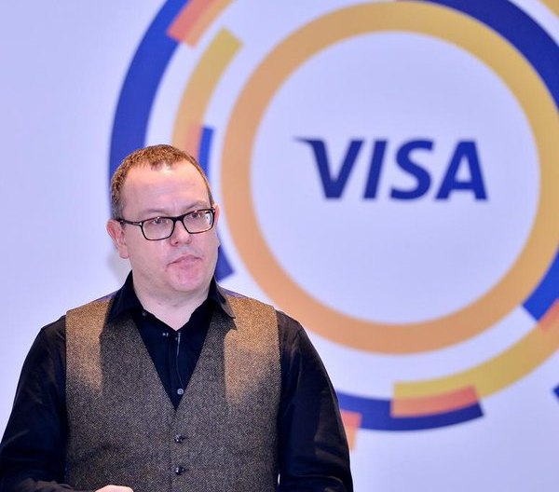
“
Biometric identification and verification has created a great deal of excitement in the payments space because it offers an opportunity to streamline and improve the customer experience
”
Jonathan Vaux
Executive director of innovation
partnerships at Visa Europe

Slide 23
Business always has its own questions …
?
?
?
?
?

Slide 24
Numbers from 2014
Banca Sella POS
75K
93k
7BL
01
03
POS Total number of Devices
Transactions per device
02
POS Total Transactions
24
24

Slide 25
F Pay POS Development
App Development
48K
Requires 4 developers for 6 month span
350
Fingerprint Scanner Module
Fingerprint scanner modules are plug and play devices ranges from 200 to 450 euros
Cost Analysis for F Pay POS
20
Card Reader Module
Card readers are also plug and play devices and cost around 20 euros
40K
Infrastructure
Mobile or Tablet
150
F Pay Server Maintenance Cost
If customer doesn’t have mobile or tablet with him then we provide device
25
25

Slide 26
Break Even Point
9K
0.10 Cents
2 Months
Average Transaction Fee
Break Even Point
530
93000 * 0.10 = 9300 € / year
26
26

Slide 27
Revenue Model per POS
10230 €
12090 €
10%
30%
20%
40%
11160 €
13020 €
27
27

Slide 28
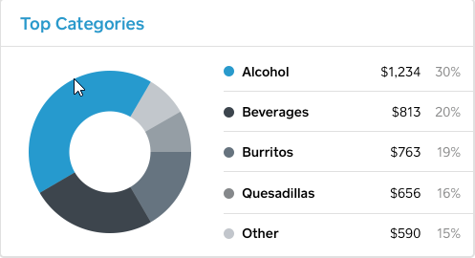
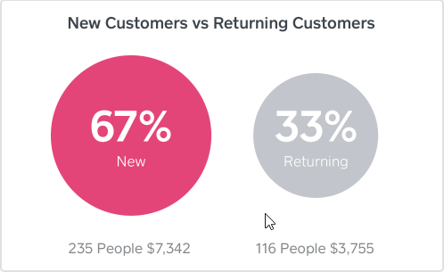
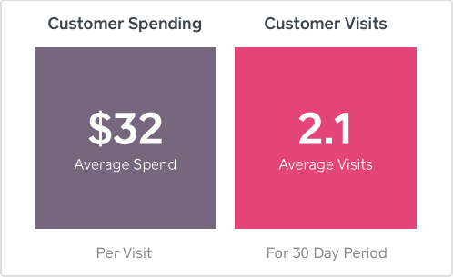
Business Insights

Slide 29
References
https://www.visaeurope.com/newsroom/news/european-consumers-ready-for-biometrics
http://www.garanteprivacy.it/web/guest/home/docweb/-/docweb-display/docweb/3590114

Slide 30
Its Time for Playground
Lets get our hand dirty

Slide 31
Thank You For Lıstenıng
We love to hear you
Feel free to say hi! If you have anything to ask
Arulraj
Saravanan
Srikrishna

